Slide 1
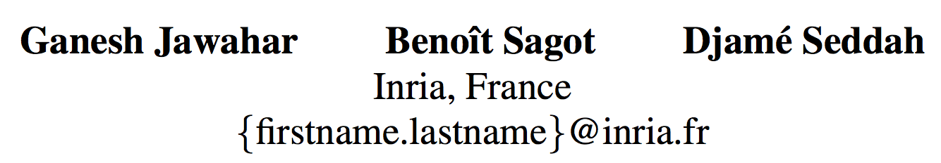
What does BERT learn about the structure of language?
ACL 2019
Sophie
2019.10.16

Slide 2
Contents
BERT Architecture
Experiments to explore the BERT architecture
Conclusion

Slide 3
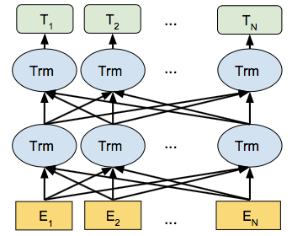
BERT
Contextualized word embedding model with Bidirectional variant of Transformer networks.
Tasks:
Masked LM: jointly predict the mask word.
Next Sentence Prediction
Achievement
Get state-of-the-art results on 11 NLP tasks
GLUE
SQuAD v1.1

Slide 4
BERT
Contextualized word embedding model with Bidirectional variant of Transformer networks.
Tasks:
Masked LM: jointly predict the mask word.
Next Sentence Prediction
Achievement
Get state-of-the-art results on 11 NLP tasks
GLUE
SQuAD v1.1
BERT networks capture structural information about language.

Slide 5
Interpretability of BERT
The linguistic structure learned by BERT’s representations.
Understand:
The reason of BERT’s excellent performance.
The limitation of BERT.
English (bert-base-uncased): 12 layers, each having a hidden size of 768 and 12 attention heads (110M parameters)

Slide 6
Experiments
Phrasal Syntax
Probing Tasks
Subject-Verb Agreement
Compositional Structure

Slide 7




Experiment 1 - Phrasal Syntax
Dataset: CoNLL 2000 chunking dataset
Example:
[NP He] [VP reckons] [NP the current account deficit] [VP will narrow]
Phrase-level information
A token sequence: e.g. [the current account deficit]
Span representation:
Syntactic symbol: e.g. NP VP ADJP PP
[ , ]

Slide 8
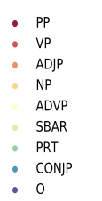
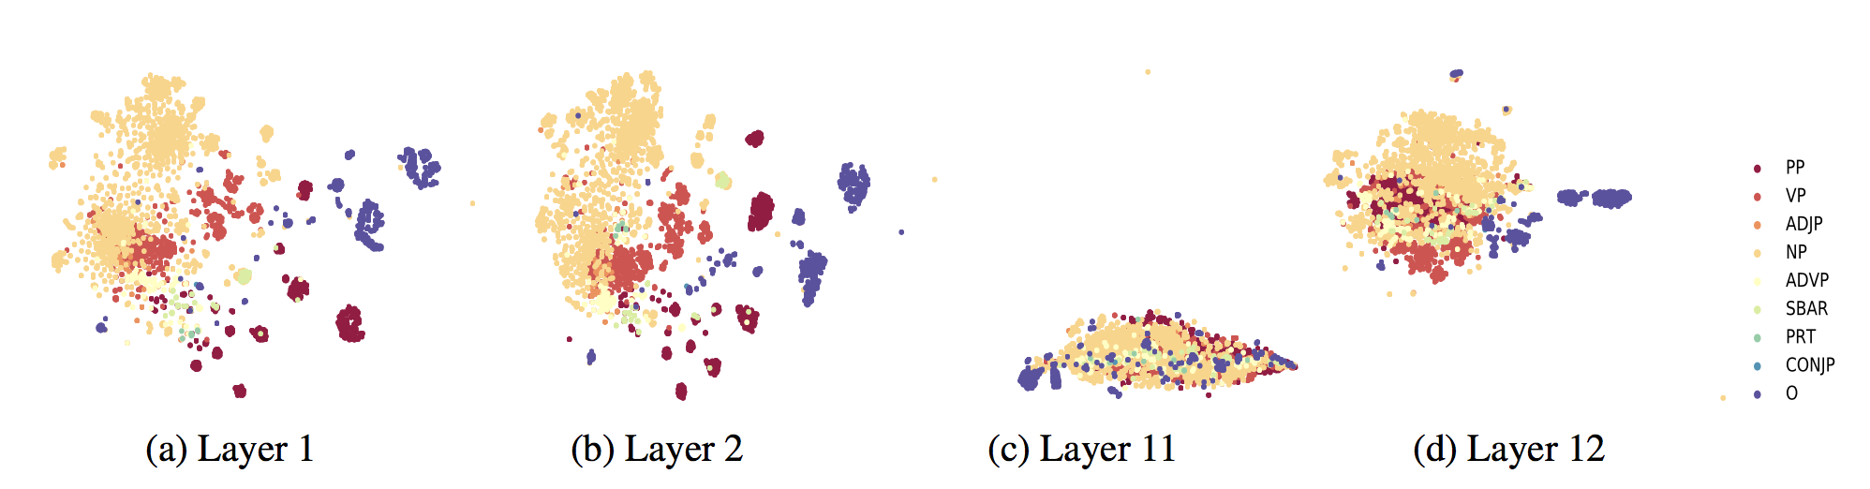
Experiment 1 - Phrasal Syntax
t-SNE: a non-linear dimensionality reduction algorithm for visualizing high-dimensional data

Slide 9
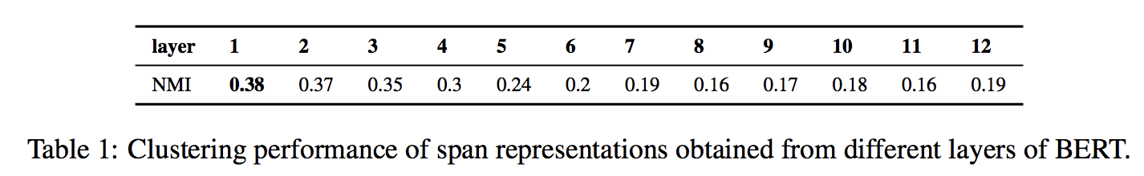
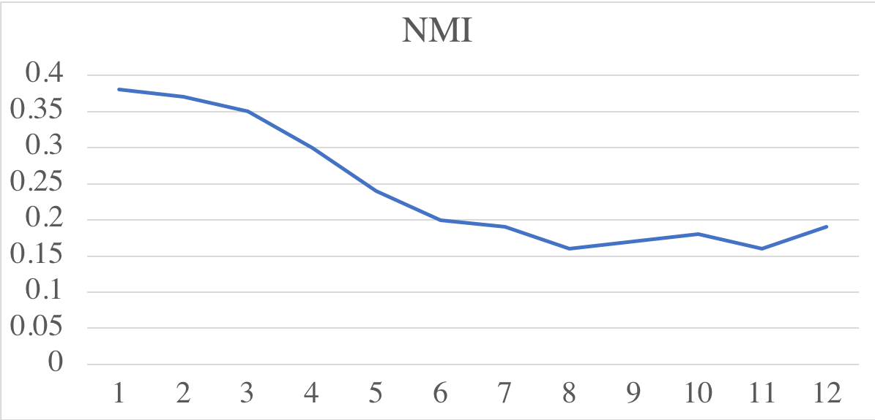
Experiment 1 - Phrasal Syntax
BERT’s phrasal representation captures phrase-level information in the lower layers, which gets diluted (稀释) in the upper layers.
NMI
BERT Layer
BERT captures phrase-level information in the lower layers.
The phrase-level information gets diluted in the upper layers.

Slide 10
Experiment 2 - Probing Tasks
Probing task: Setting up an auxiliary classification task where the final output of a model is used as features to predict a linguistic phenomenon of interest.
Predict
Sentence Length
Simple Classifier
BERT Layer

Slide 11
Experiment 2 - Probing Tasks
Probing task: Setting up an auxiliary classification task where the final output of a model is used as features to predict a linguistic phenomenon of interest.
10 probing sentence-level datasets/tasks:
Surface tasks:
sentence length
presence of words in the sentence
Syntactic tasks:
sensitivity to word order
depth of the syntactic tree
sequence of top-level constituents in the syntax tree
Semantic tasks:
tense
subject number in the main clause
the sensitivity to random replacement of a noun/verb
the random swapping of coordinated clausal conjuncts
Predict
Sentence Length
Simple Classifier
BERT Layer

Slide 12
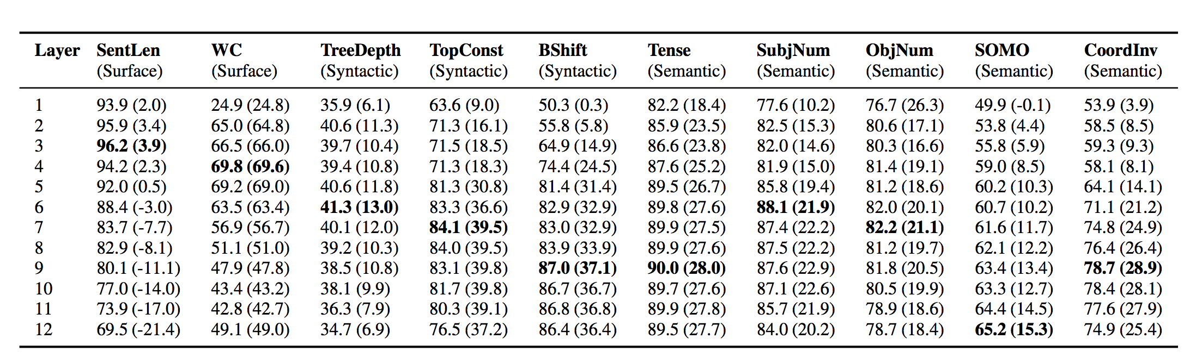
Experiment 2 - Probing Tasks

Slide 13
Experiment 2 - Probing Tasks

Slide 14
Experiment 3 - Subject-Verb Agreement
Classify if the main verb is singular or plural based on its subject
The challenge of the task:
More nouns with opposite number (attractors) intervening between the subject and the verb.
The length of the forewings is 12-13.
The ratio of men who survive to the women and children who survive is not clear in this story.

Slide 15
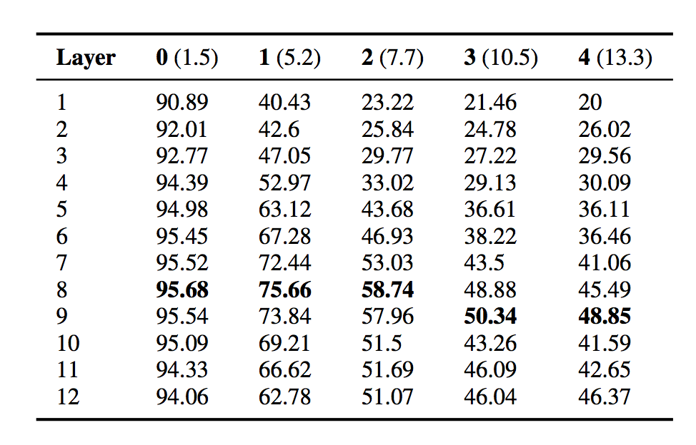
Experiment 3 - Subject-Verb Agreement

Slide 16
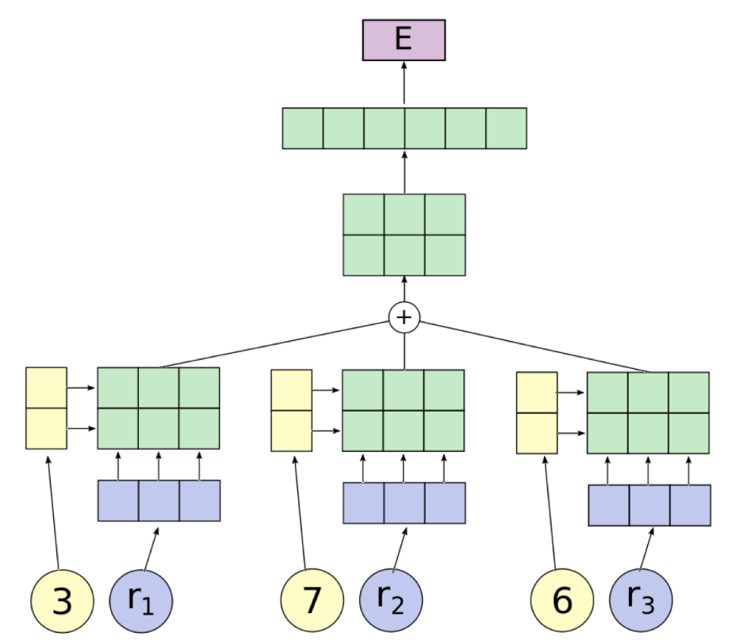
Experiment 4 - Compositional Structure
Tensor Product Composition Network (TPDN)
Uncovering compositional structure in neural networks
McCoy R T, Linzen T, Dunbar E, et al. RNNs Implicitly Implement Tensor Product Representations[J]. arXiv preprint arXiv:1812.08718, 2018.

Slide 17
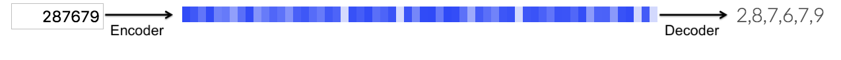
TPDN
Task : Copy a sequence of digits

Slide 18
TPDN
Task : Copy a sequence of digits

Slide 19
TPDN
Task : Copy a sequence of digits
filler/role representations of symbolic tasks.
Hypothesis:
Neural networks trained to perform symbolic tasks will implicitly implement filler/role representations.

Slide 20
TPDN
Task : Copy a sequence of digits
2 , 8 , 7 , 6 , 7， 9 = 2 : first + 8 : second + 7 : third + 6 : fourth + 7 : fifth + 9 : sixth
sequence’s fillers
fillers’ roles
Hypothesis:
Neural networks trained to perform symbolic tasks will implicitly implement filler/role representations.

Slide 21
TPDN
Analogies
king = royal : status + male : gender
queen = royal : status + female : gender
man = commoner : status + male : gender
woman = commoner : status + female : gender
filler/role
representation
king - queen = man - woman

Slide 22
TPDN
Analogies
king = royal : status + male : gender
queen = royal : status + female : gender
man = commoner : status + male : gender
woman = commoner : status + female : gender
filler/role
representation
king - queen = man - woman
king - queen = ( royal : status + male : gender ) -( royal : status + female : gender )
man - woman = ( commoner : status + male : gender ) - ( commoner : status + female : gender )
male : gender - female : gender

Slide 23
TPDN
Input sequence: 3, 7, 6
 | 3 | 7 | 6
Left-to-right
Right-to-left
Bidirectional
Bag-of-words
Tree
Notes:
Now we know what is the filler/role representations.
Then I'll talk about the structure of TPDN.
For this model, the input is the filler/role representations we talked about.
We can use some rules to conduct the filler representation for the input sequence.
The table

Slide 24
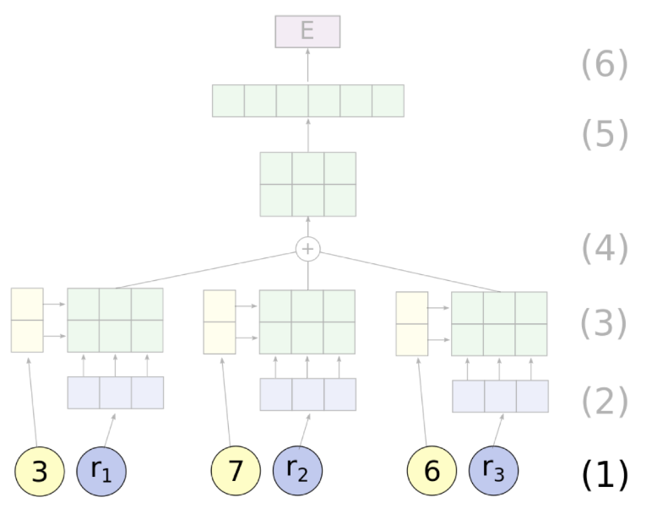
TPDN
Input sequence: 3, 7, 6
 | 3 | 7 | 6
Left-to-right
Right-to-left
Bidirectional
Bag-of-words
Tree

Slide 25
TPDN
Input sequence: 3, 7, 6
 | 3 | 7 | 6
Left-to-right | 0 | 1 | 2
Right-to-left
Bidirectional
Bag-of-words
Tree
3 : first + 7 : second + 6 : third

Slide 26
TPDN
Input sequence: 3, 7, 6
 | 3 | 7 | 6
Left-to-right | 0 | 1 | 2
Right-to-left | 2 | 1 | 0
Bidirectional
Bag-of-words
Tree
3 : third-to-last + 7 : second-to-last + 6 : last

Slide 27
TPDN
Input sequence: 3, 7, 6
 | 3 | 7 | 6
Left-to-right | 0 | 1 | 2
Right-to-left | 2 | 1 | 0
Bidirectional | (0, 2) | (1, 1) | (2, 0)
Bag-of-words
Tree
3 : (0, 2) + 7 : (1, 1) + 6 : (2, 0)

Slide 28
TPDN
Input sequence: 3, 7, 6
 | 3 | 7 | 6
Left-to-right | 0 | 1 | 2
Right-to-left | 2 | 1 | 0
Bidirectional | (0, 2) | (1, 1) | (2, 0)
Bag-of-words | r₀ | r₀ | r₀
Tree
3 : r₀ + 7 : r₀ + 6 : r₀

Slide 29
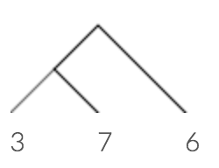
TPDN
Input sequence: 3, 7, 6
 | 3 | 7 | 6
Left-to-right | 0 | 1 | 2
Right-to-left | 2 | 1 | 0
Bidirectional | (0, 2) | (1, 1) | (2, 0)
Bag-of-words | r₀ | r₀ | r₀
Tree | LL | LR | R

Slide 30
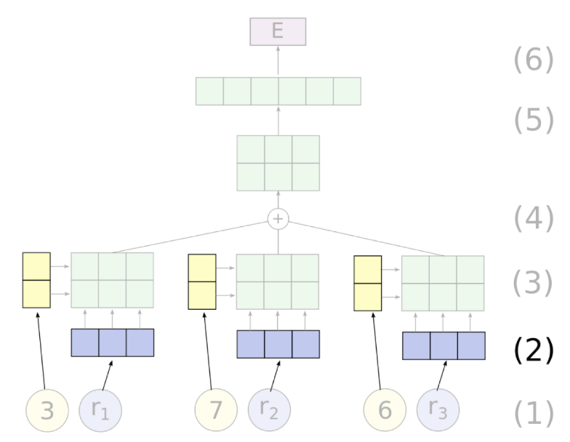
TPDN
Notes:
Embed each filler and each role by looking up its learned representation in a dictionary.

Slide 31
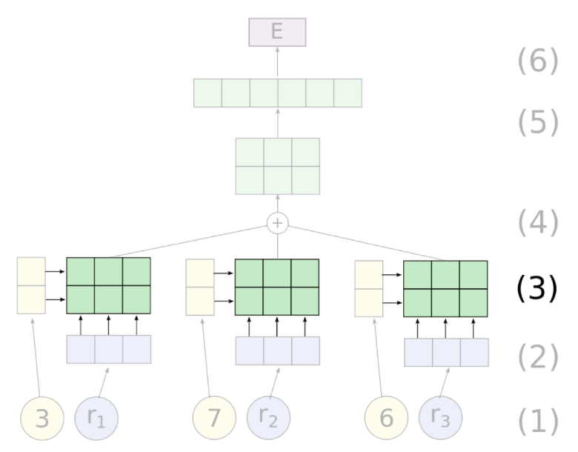
TPDN
Notes:
Bind the filler and role vectors using the tensor product.

Slide 32
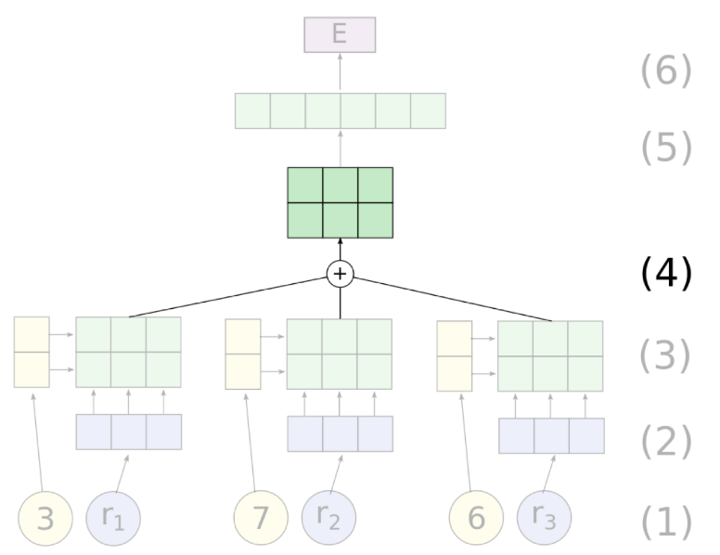
TPDN
Notes:
Sum the tensor products.

Slide 33
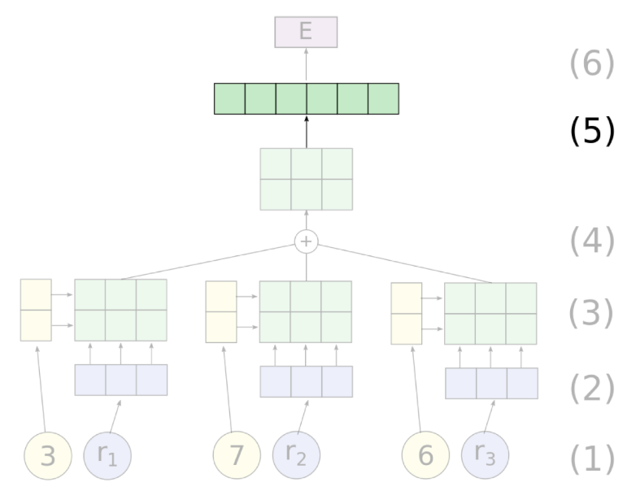
TPDN
Notes:
Flatten the sum into a vector by concatenating its rows.

Slide 34
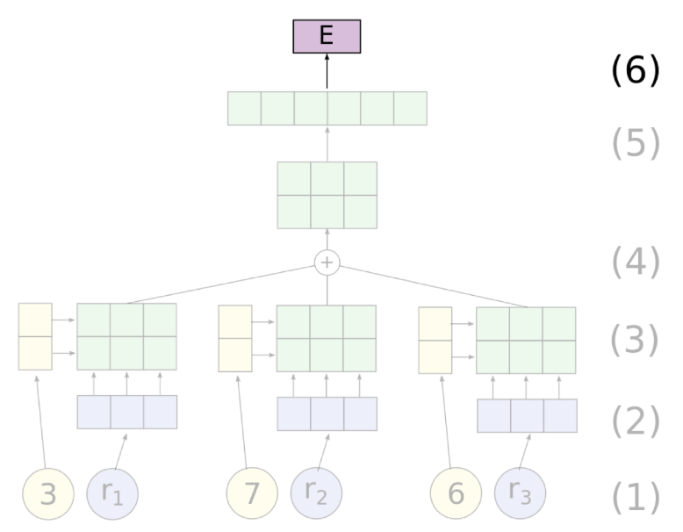
TPDN
Notes:
Apply a linear transformation to the sum to generate the final encoding, E.

Slide 35
Experiment 4 - Compositional Structure
Notes:
The TPDN can embed a sequence with its special filler/role representation into a vector.

Slide 36
Experiment 4 - Compositional Structure
Quiz: How is TPDN used to describe the compositional structure of BERT?
Notes:
fit a Tensor Product Representation onto a set of vector representations such that the vector encodings produced by the TPDN are as close as possible to the vector encodings produced by the RNN.
We initialize the filler embeddings of the TPDN with the pre-trained word embeddings from BERT’s input layer, freeze it, learn a linear projection on top of it and use a Mean Squared Error (MSE) loss function.
If the vector encodings produced by the TPDN are close to the vector encodings produced by BERT, this compositional structure can be regarded decoded.

Slide 37
Experiment 4 - Compositional Structure
Quiz: How is TPDN used to describe the compositional structure of BERT?
BERT representation
Left-to-right
Right-to-left
Bag-of-words
Bidirectional
Tree : Stanford PCFG Parser
Notes:
We initialize the filler embeddings of the TPDN with the pre-trained word embeddings from BERT’s input layer, freeze it, learn a linear projection on top of it and use a Mean Squared Error (MSE) loss function.
If the vector encodings produced by the TPDN are close to the vector encodings produced by BERT, this compositional structure can be regarded decoded.

Slide 38
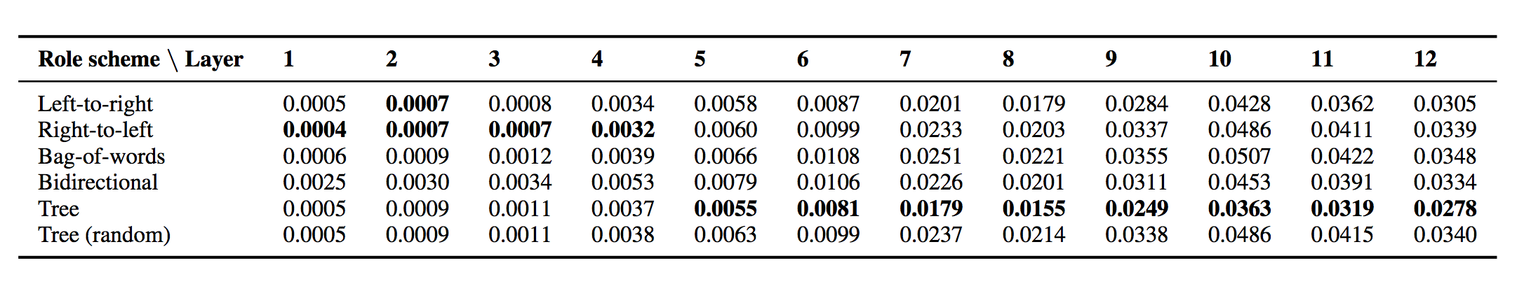
Experiment 4 - Compositional Structure
Notes:
BERT implicitly implements a tree-based scheme, as a TPDN model following that scheme best approximates BERT’s representation at most layers.
BERT encodes classical, tree-like structures despite relying purely on attention mechanisms.

Slide 39
Summary
BERT’s phrasal representation captures phrase-level information in the lower layers, which gets diluted in the upper layers.
BERT’s intermediate layers encode a rich hierarchy of linguistic information, with surface features at the bottom, syntactic features in the middle and semantic features at the top.
BERT turns out to require deeper layers when long-distance dependency information is required. e.g. track subject-verb agreement
BERT representations capture linguistic information in a compositional way that mimics classical, tree-like structures.

Slide 40
Conclusion
Rich experiments to understand the internal structure of the BERT
More comparison with other models?
TPDN used to interpret RNNs

Slide 41
Thanks for Listening!
Sophie
2019.10.16

